Slide 1
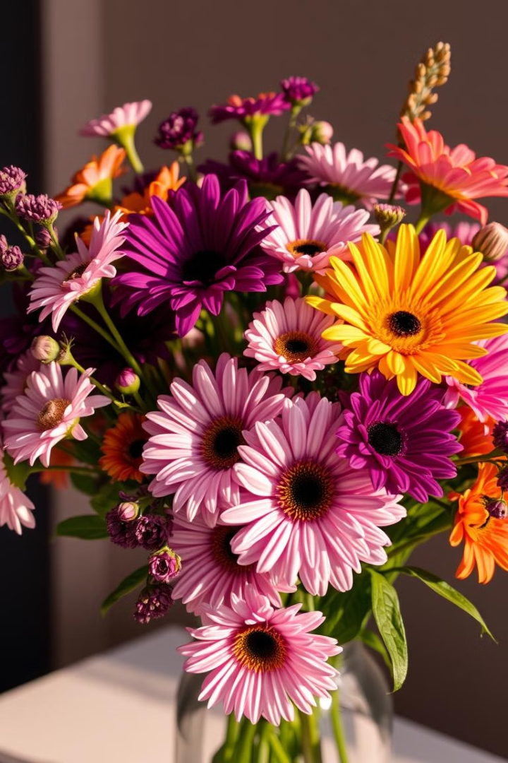

Online Flower and Gift Ordering System
Discover our seamless and user-friendly platform for ordering flowers, gifts, and more. With a wide selection and reliable delivery, we strive to make every occasion special.
by Praveen Kumar.

Slide 2

Introduction to our Service
1
Comprehensive Catalog
2
Convenient Ordering
Easily place orders through our user-friendly website or mobile app, anytime, anywhere.
Browse our extensive collection of fresh flowers, plants, and thoughtful gifts for any event.
3
Fast Delivery
Count on timely and reliable delivery to your doorstep or the recipient's location.

Slide 3
Key Features and Capabilities
Customization
Subscription Options
Real-Time Tracking
Personalize your orders with custom notes, gift wrapping, and add-ons to make each delivery truly unique.
Enjoy the convenience of regular flower or gift deliveries with our flexible subscription plans.
Stay informed about your order's progress through live updates and delivery notifications.

Slide 4

The Ordering Process
1
Browse
Explore our extensive collection of flowers, plants, and gifts to find the perfect item for your occasion.
2
Select
Customize your order with personalized notes, gift wrapping, and delivery instructions.
3
Checkout
Securely complete your purchase using your preferred payment method.

Slide 5
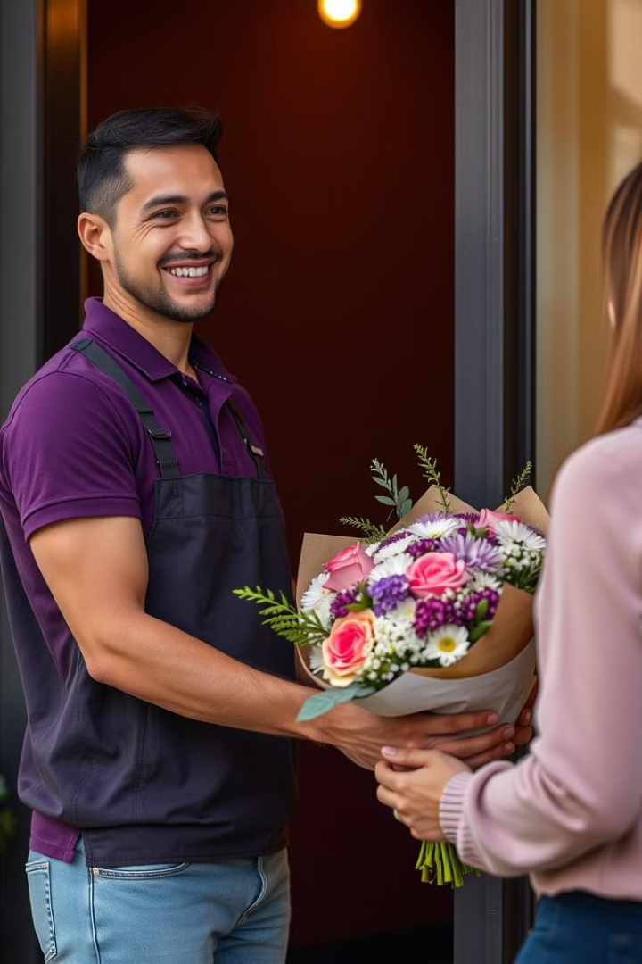



Delivery and Fulfillment
Same-Day Delivery
In select areas, we offer same-day delivery to ensure your order arrives on time.
Scheduled Delivery
Choose a specific date and time for your delivery to fit your schedule.
Gift Packaging
Our team carefully packages your order to ensure it arrives in pristine condition.

Slide 6

Secure Payments and Customer Data Protection
Payment Security
Privacy Policy
Customer Support
We use industry-standard encryption and secure payment gateways to protect your financial information.
Your personal data is kept confidential and is never shared with third parties without your consent.
Our dedicated customer service team is available to assist you with any questions or concerns.

Slide 7
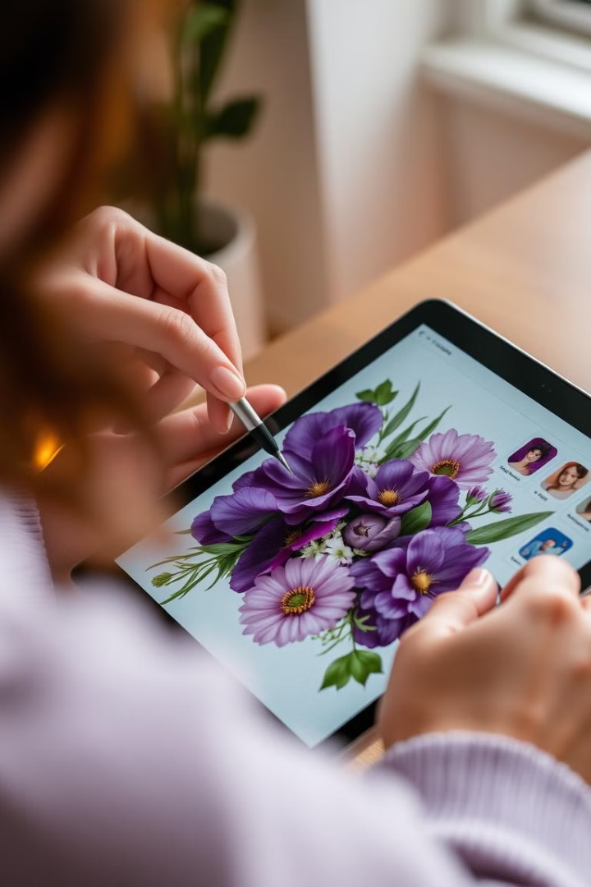



Personalization and Customization Options
Custom Notes
Include a personalized message to make your gift even more meaningful.
Gift Wrapping
Choose from a variety of elegant wrapping options to elevate your presentation.
Subscription Plans
Enjoy regular flower or gift deliveries with our convenient subscription services.

Slide 8

Conclusion
At our online flower and gift ordering system, we are committed to making every occasion special. With our wide selection, personalization options, and reliable delivery, we strive to exceed your expectations and bring joy to your loved ones.

